Slide 1
Spring Boot

Slide 2
Introduction
Spring Boot is a Spring module that provides the RAD (Rapid Application Development) feature to the Spring framework.
Spring Boot is an open source Java-based framework used to create a micro Service.
It is developed by Pivotal Team.
Spring Boot is the combination of Spring framework and Embedded Server (like Tomcat).
In early 2013, Spring Boot was made.

Slide 3
Spring Boot Features
Create stand-alone Spring applications
Embedded Servers like Tomcat, Jetty or Undertow directly (no need to deploy WAR files)
Automatically configure Spring and 3rd party libraries whenever possible.
Provide production-ready features such as metrics, health checks, and externalized configuration
Absolutely no code generation and no requirement for XML configuration.

Slide 4
Creating Spring Boot Project
Install Eclipse IDE for Enterprise Java and Web Developer
Create a Spring Boot Project in Spring Initializr.
Add Dependency : Spring Web
Import Spring Boot Project in Eclipse IDE
Search “maven” and choose Existing Maven Project
Choose Next Click on the Browse button and select the extracted zip
Click on the Finish button and we are done creating the Spring Boot project

Slide 5
Spring Core
Spring framework was initially written by Rod Johnson and was first released under the Apache 2.0 license in June 2003.
Spring framework is an open source Java platform that provides comprehensive infrastructure support for developing robust Java applications very easily and very rapidly.
It can be thought of as a framework of frameworks because it provides support to various frameworks such as Hibernate, Tapestry, EJB, JSF, etc.

Slide 6
Ioc Container
The Spring Inversion of Control container is at the core of the Spring Framework.
The container will create the objects, wire them together, configure them, and manage their complete life cycle from creation till destruction.
The Spring container uses DI to manage the components that make up an application. These objects are called Spring Beans.
The Spring IoC container makes use of Java POJO classes and configuration metadata to produce a fully configured and executable system or application.

Slide 7
Spring BeanFactory Container :
the BeanFactory is an interface that provides basic functionality for managing and manipulating beans.
These beans typically collaborate with one another, and thus have dependencies between themselves.
BeanFactory is the actual container which instantiates, configures, and manages a number of beans.
Spring ApplicationContext Container :
This container adds more enterprise-specific functionality.
Such as the ability to resolve textual messages from a properties file.
the ability to publish application events to interested event listeners.
This container is defined by the org.springframework.context.ApplicationContext interface.

Slide 8
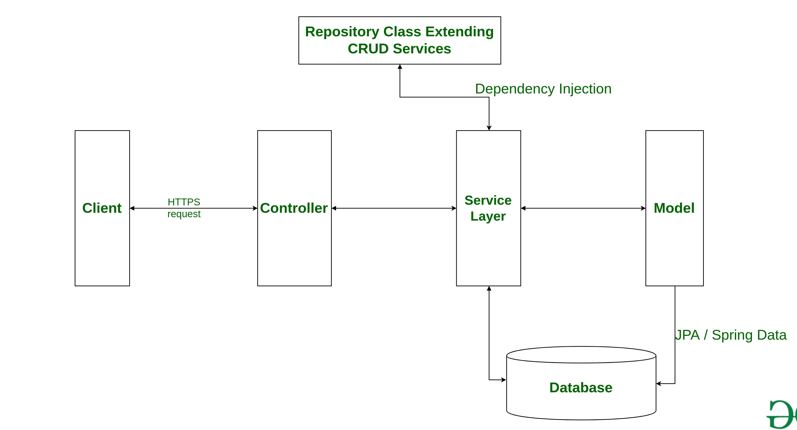
Spring Boot Architecture

Slide 9
Layers in Spring Boot:
There are four main layers in Spring Boot:
Presentation Layer:
Authentication & Json Translation. It consists of Views.
Business Layer:
Business Logic, Validation & Authorization. It consists of services classes.
Persistence Layer:
It is responsible for converting business objects to the database row and vice-versa (storage Logic).
Database Layer:
Actual Database It is responsible for performing the CRUD operations.

Slide 10
Spring Boot Annotation
Spring Boot Annotations are a form of metadata that provides data about a spring application.
In other words, annotations are used to provide supplemental information about a program.
For Example:
@SpringBootApplication :
This annotation is used to mark the main class of a Spring Boot application.
@Component :
It is a class-level annotation.
It is used to mark a Java class as a bean.

Slide 11
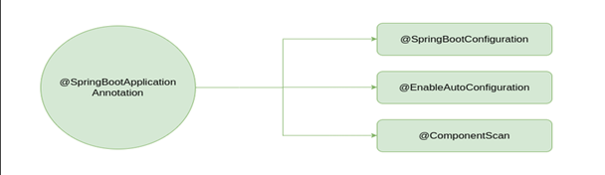
Spring Boot Annotations List
Some of the annotations that are available in this category are:
@SpringBootApplication
@SpringBootConfiguration
@EnableAutoConfiguration
@ComponentScan

Slide 12
Example:
Create a Springboot project and a Developer Class with build() method.
Make Developer Class as @Component so it can create bean in Ioc container.
Create Object(context) for ApplicationContext interface to call bean.
Create Object for Developer using getBeam(class-name.class) method.
Using spring object call the build() method.
Public class SpringApp {
public static void main(String[] a) {
ApplicationContext context =
SpringApp.run(‘…’);
Developer obj = context.getBean(Developer.class);
obj.build();
}
Developer.java :
@Component
Public class Developer {
public void build() {
s.o.p(“Working…”);
}}

Slide 13
Annotations:
@Autowire :
It is used to autowire(connecting) spring bean on setter methods, instance variable, and constructor Injection.
@Primary :
Giving priority to a Bean when we have more than one class with same method and component.
@Qualifier(‘class-name’) :
Giving priority to a Bean which given inside when we have more than one class with same method and component.
This is Given inside main class.

Slide 14
Example:
Laptop.java :
@Component
Public class Laptop {
public void compile() {
s.o.p(“Compiling…”);
}}
Developer.java :
@Component
Public class Developer {
private Laptop lap; //constructor inject
public Developer(Laptop lap) {
this.lap = lap;
}
public void build() {
s.o.p(“Working…”);
}}
Developer.java :
@Component
Public class Developer {
//field injection
@Autowired
private Laptop lap;
//setter injection
public void setLaptop(Laptop lap) {
this.lap = lap;
}
public void build() {
lap.compile();
s.o.p(“Working…”);
}}

Slide 15
Example:
Computer.java (interface):
Public interface Computer {
void compile();
}
Developer.java :
@Component
Public class Developer {
@Autowired
@Qualifier(“laptop”) //priority
private Computer comp;
public void build() {
comp.compile();
s.o.p(“Working…”);
}}
Laptop.java :
@Component
Public class Laptop implements Computer {
public void compile(){
s.o.p(“Compiling in laptop…”);
}}
Desktop.java :
@Component
@Primary //priority given
Public class Desktop implements Computer {
public void compile(){
s.o.p(“Compiling in desktop…”);
}}

Slide 16
@RestController: It marks a class as a web request and response handler. It is mostly used with @RequestMapping.
@Controller: It is also marks a class as a web request handler. It is mostly used with @RequestMapping annotation.
@RequestMapping(“/”): It is used to redirect the page which is mentioned inside the (“/”).
@ResponseBody: It is mostly used with @RequestMapping annotation to pass the response from body incase you are using only @Controller not @RestController.
@Service: It is also used at class level. It tells the Spring that class contains the business logic.
@Bean: It is a method-level annotation. It is an alternative of XML <bean> tag. It tells the method to produce a bean to be managed by Spring Container.

Slide 17
Spring RESTful API
RESTful Web Services REST stands for REpresentational State Transfer.
It was developed by Roy Thomas Fielding, one of the principal authors of the web protocol HTTP.
Consequently, REST was an architectural approach designed to make the optimum use of HTTP protocol.
It uses the concepts and verbs already present in HTTP to develop web services.
We can build REST web services using many representations, including both XML and JSON, although JSON is the more popular option.

Slide 18
Spring Web HTTP Method:
GET: It reads a resource(web page).
PUT: It updates an existing resource.
POST: It creates a new resource(data sharing).
DELETE: It deletes the resource
HTTP standard status code:
404: RESOURCE(Page) NOT FOUND
200: SUCCESS
201: CREATED
401: UNAUTHORIZED
500: SERVER ERROR

Slide 19
HTTP Methods Annotation:
It is used to map the HTTP requests with the handler methods inside the controller class.
@GetMapping : It is used to create a web service endpoint that fetches.
@PutMapping : It is used to create a web service endpoint that creates or update.
@PostMapping : to create a web service endpoint that creates.
@DeleteMapping : to create a web service endpoint that deletes a resource.

Slide 20
@PathVariable
It is used to extract the data from the URI path.
@RequestBody
It is used to convert HTTP requests from incoming JSON format to domain objects directly from request body.
@ResponseBody
It is used to convert the domain object into HTTP request in the form of JSON or any other text.
Note: Jackson library file is responsible to convert object into JSON vise versa.

Slide 21
Spring JDBC
Spring Boot JDBC is used to connect the Spring Boot application with JDBC by providing libraries and starter dependencies.
Spring Data JPA
It handles most of the complexity of JDBC-based database access and ORM.
It reduces the boilerplate code required by JPA.
No-code repository: It is the most popular persistence-related pattern.
Another feature of Spring Data JPA is the generation of database queries based on the method name.

Slide 22
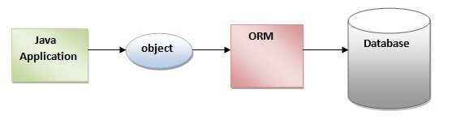
ORM TOOL
An ORM tool simplifies the data creation, data manipulation and data access.
It allows us to access and persist data between Java object/ class and relational database.
JPA :
Java Persistence API (JPA) is a Java specification that provides certain functionality and standard to ORM tools.
The javax.persistence package contains the JPA classes and interfaces.

Slide 23
Spring MicroServices
Microservice Architecture is a Service Oriented Architecture.
In this there are a large number of microservices by combining all the microservices, it constructs a big service.
In the microservice architecture, all the services communicate with each other.
Each microservice runs its process and communicates with lightweight mechanisms.
These are the services which are exposed by REST.

Slide 24
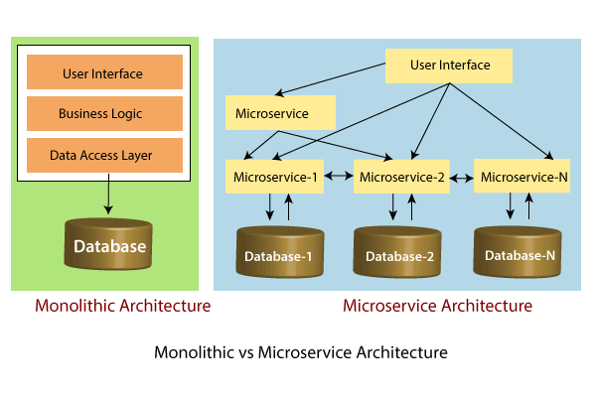

Slide 25
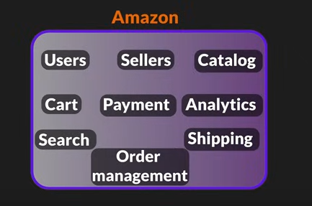
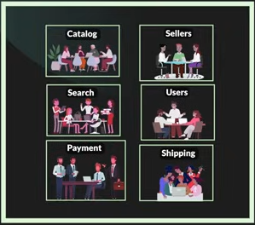
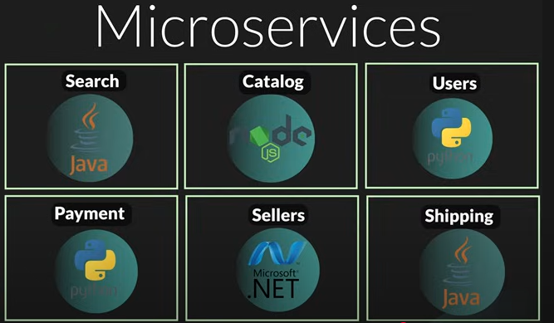
To Develop an application we need to create modules.
After creating all modules if we connect them in one package its called Monolithic Architecture
If we are doint it as a different service and using differen technologies it is called Microservices.
Monolithic Arch

Slide 26
Hibernate:
Hibernate is a Java framework that simplifies the development of Java application to interact with the database.
It is an open source, lightweight, ORM (Object Relational Mapping) tool.
Hibernate implements the specifications of JPA (Java Persistence API) for data
It was started in 2001 by Gavin King as an alternative to EJB2 style entity bean.

Slide 27
Maven:
Maven is a powerful project management tool that is based on POM (project object model).
It is used for projects build, dependency and documentation.
It makes a project easy to build
It provides uniform build process (maven project can be shared by all the maven projects)
It provides project information (log document, cross referenced sources, mailing list, dependency list, unit test reports etc.)
It is easy to migrate for new features of Maven

